Slide 1
Module 2, Part 2: Random Vectors, Covariance, Multivariate Normal Distribution TMA4268 Statistical Learning V2023
Daesoo Lee,
Department of Mathematical Sciences, NTNU
19/01/2023

Slide 2


Slide 3
Quiz (advised by ChatGPT)

Slide 4

Quiz
https://www.whichfaceisreal.com/

Slide 5
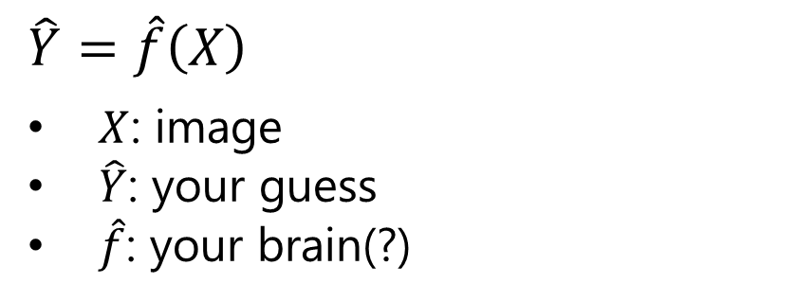
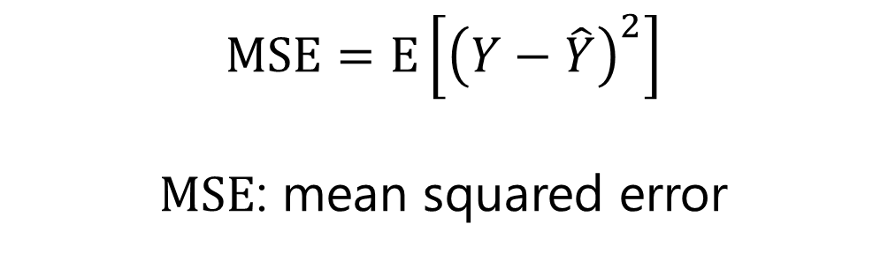
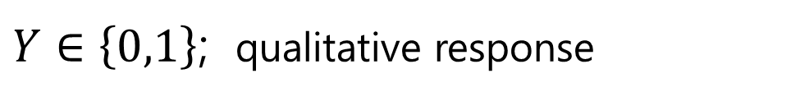
Quiz
https://www.whichfaceisreal.com/
$Y∈\left\{0,1\right\}$; qualitative response
$$MSE=E\left[{\left(Y−\hat{Y}\right)}^{2}\right]$$
$MSE$: mean squared error
$$\hat{Y}=\hat{f}\left(X\right)$$
$X$: image
$\hat{Y}$: your guess
$\hat{f}$: your brain(?)

Slide 6
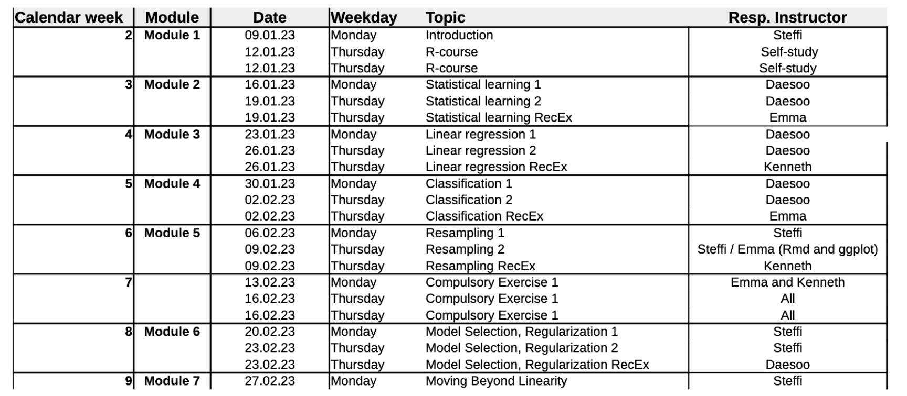
Course Schedule

Slide 7
Overview

Slide 8
Overview
Random vectors
The covariance and correlation matrix
The multivariate normal distribution

Slide 9
Random Vector

Slide 10
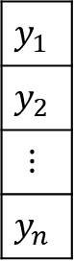
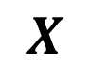
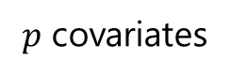
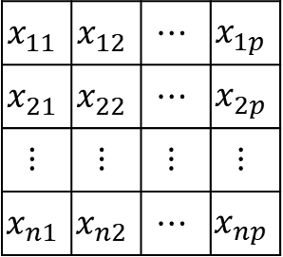
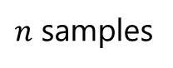
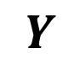
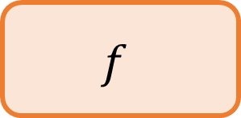
Random Vector
Recap
$$f$$
$$X$$
$$Y$$
$p$ covariates
$$x_{11}$$ | $$x_{12}$$ | $$⋯$$ | $$x_{1p}$$
$$x_{21}$$ | $$x_{22}$$ | $$⋯$$ | $$x_{2p}$$
$$⋮$$ | $$⋮$$ | $$⋮$$ | $$⋮$$
$$x_{n1}$$ | $$x_{n2}$$ | $$⋯$$ | $$x_{np}$$
$$y_{1}$$
$$y_{2}$$
$$⋮$$
$$y_{n}$$
$n$ samples

Slide 11

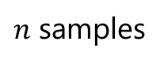
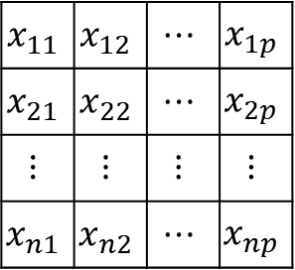
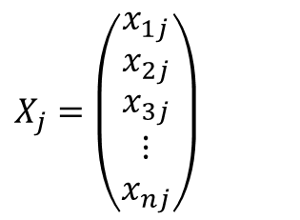
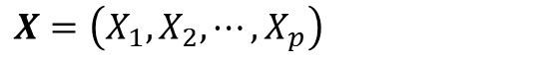
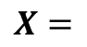
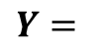
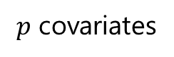
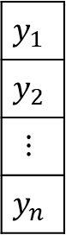
Random Vector
$p$ covariates
Recap
$$x_{11}$$ | $$x_{12}$$ | $$⋯$$ | $$x_{1p}$$
$$x_{21}$$ | $$x_{22}$$ | $$⋯$$ | $$x_{2p}$$
$$⋮$$ | $$⋮$$ | $$⋮$$ | $$⋮$$
$$x_{n1}$$ | $$x_{n2}$$ | $$⋯$$ | $$x_{np}$$
$$X=$$
$n$ samples
$$X=\left(X_{1},X_{2},⋯,X_{p}\right)$$
$$X_{j}=\left(\begin{matrix}x_{1j} \\ x_{2j} \\ \begin{matrix}x_{3j} \\ ⋮ \\ x_{nj}\end{matrix}\end{matrix}\right)$$
Random Variable
$$y_{1}$$
$$y_{2}$$
$$⋮$$
$$y_{n}$$
$$Y=$$

Slide 12
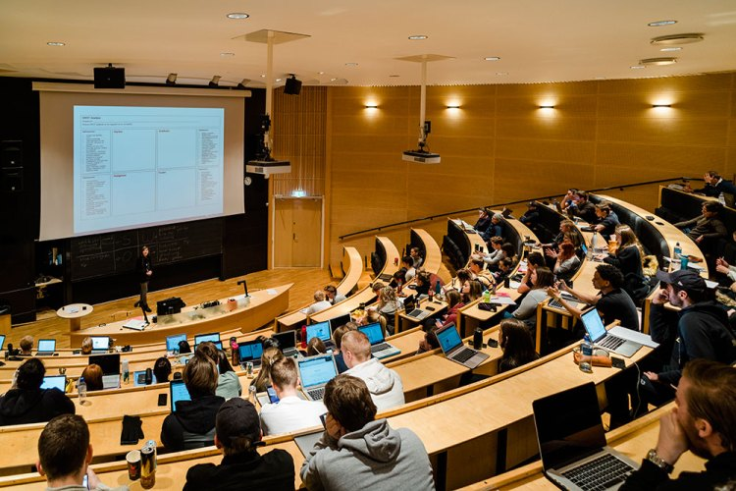
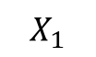
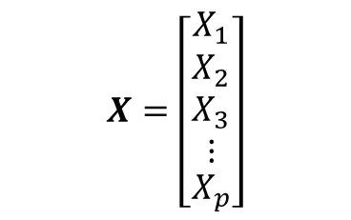
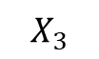
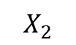
Random Vector
Random vector
$$X=\left[\begin{matrix}X_{1} \\ \begin{matrix}X_{2} \\ X_{3} \\ ⋮\end{matrix} \\ X_{p}\end{matrix}\right]$$
age
$$X_{1}$$
height
$$X_{2}$$
weight
$$X_{3}$$

Slide 13

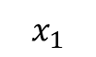

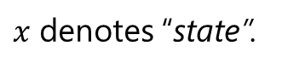
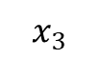


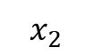
Random Vector
Random vector
$$X=\left[\begin{matrix}X_{1} \\ \begin{matrix}X_{2} \\ X_{3} \\ ⋮\end{matrix} \\ X_{p}\end{matrix}\right]$$
age
$$x_{1}$$
height
$$x_{2}$$
weight
$$x_{3}$$
NB! small $x$
$x$ denotes “state”.

Slide 14
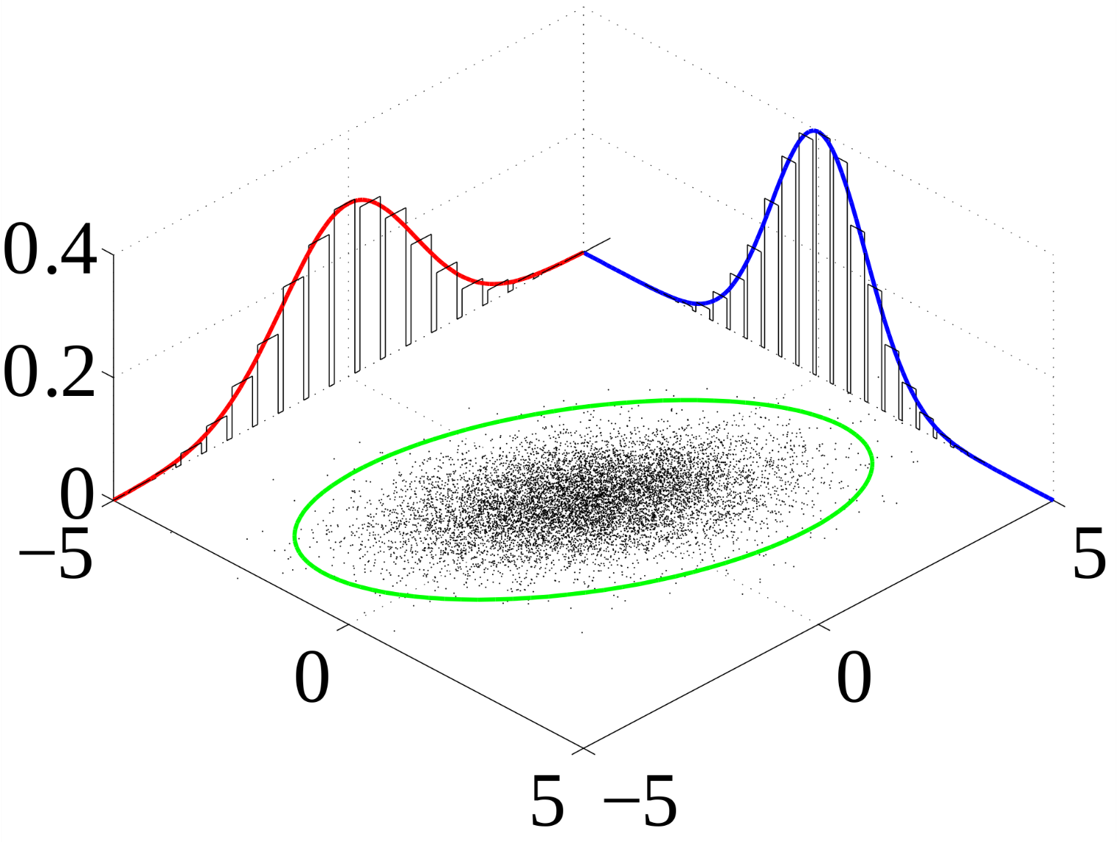

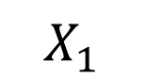
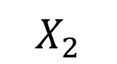
Random Vector
Joint Probability Distribution
$$X_{1}$$
$$X_{2}$$

Slide 15

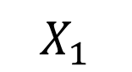
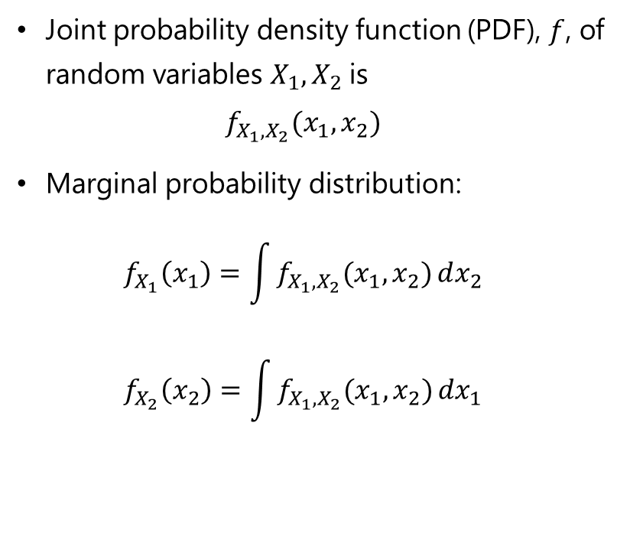
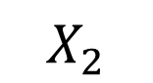
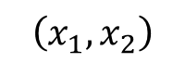
Random Vector
Joint Probability Distribution
Joint probability density function (PDF), $f$, of random variables $X_{1},X_{2}$ is $f_{X_{1},X_{2}}(x_{1},x_{2})$
Marginal probability distribution: $f_{X_{1}}\left(x_{1}\right)=\int{f_{X_{1},X_{2}}(x_{1},x_{2})}dx_{2}$ $f_{X_{2}}\left(x_{2}\right)=\int{f_{X_{1},X_{2}}(x_{1},x_{2})}dx_{1}$
$$X_{1}$$
$$X_{2}$$
$$\left(x_{1},x_{2}\right)$$

Slide 16
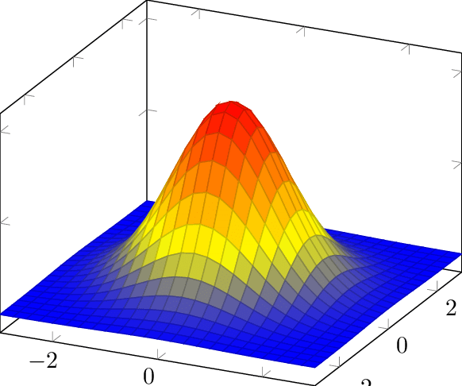
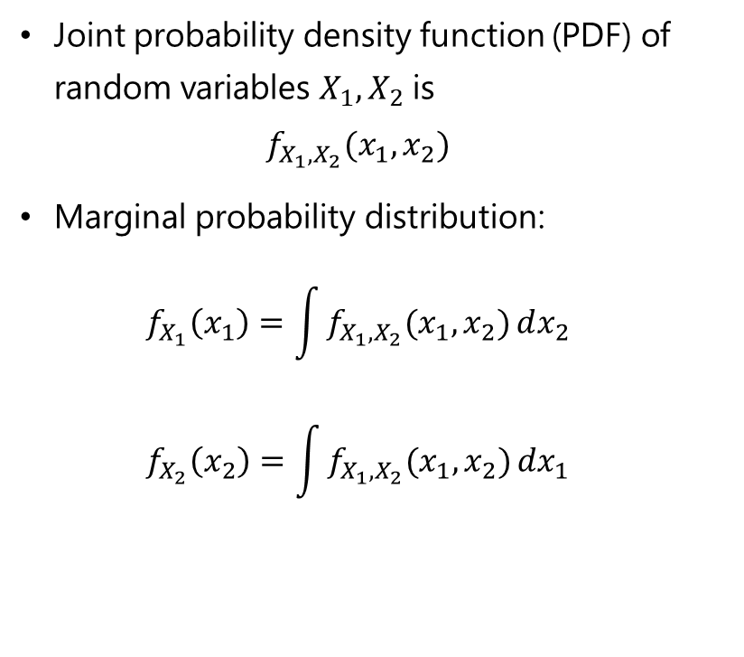
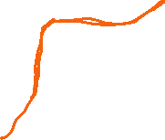
Random Vector
Joint Probability Distribution
Joint probability density function (PDF) of random variables $X_{1},X_{2}$ is $f_{X_{1},X_{2}}(x_{1},x_{2})$
Marginal probability distribution: $f_{X_{1}}\left(x_{1}\right)=\int{f_{X_{1},X_{2}}(x_{1},x_{2})}dx_{2}$ $f_{X_{2}}\left(x_{2}\right)=\int{f_{X_{1},X_{2}}(x_{1},x_{2})}dx_{1}$
$$X_{1}$$
$$X_{2}$$
$$\left(x_{1},x_{2}\right)$$

Slide 17
Random Vector
Moments of a distribution function
In mathematics, the moments of a function are certain quantitative measures related to the shape of the function's graph.
We will look at
E: Mean of random vector and random matrices. (Expectation)
Cov: Covariance matrix
Corr: Correlation matrix
E and Cov of multiple linear combinations.

Slide 18
Random Vector
Example: Boston Housing Price Dataset
It is a database with information of areas around Boston city, and the median house prices.
There are many input features, but we’ll look at
crime rate in the region
a number of rooms
home owner’s age
housing price
https://www.kaggle.com/code/andyxie/regression-with-r-boston-housing-price

Slide 19
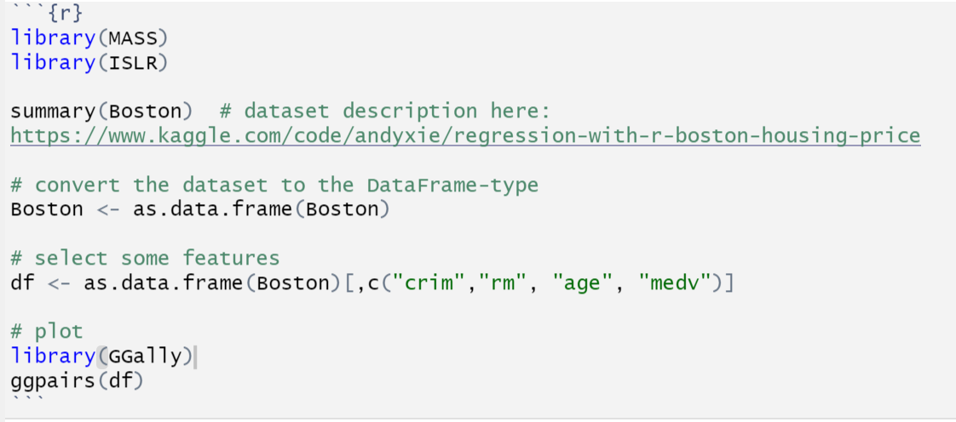
Random Vector
Example: Boston Housing Price Dataset
{crime rate in the region, a number of rooms, home owner’s age, housing price}
crim: crime rate
rm: number of rooms
age: home owner’s age
medv: housing price
https://www.kaggle.com/code/andyxie/regression-with-r-boston-housing-price

Slide 20
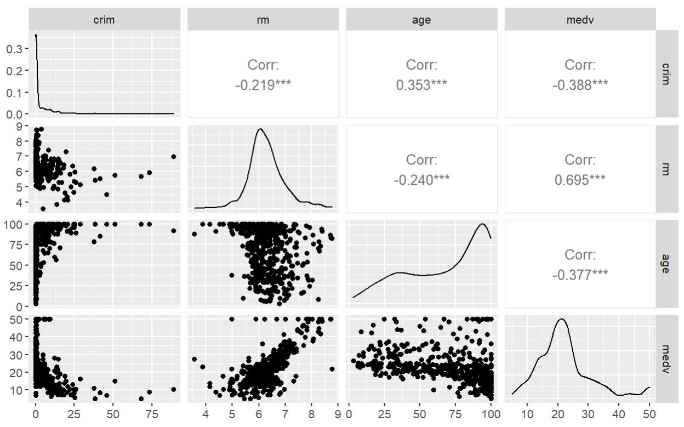
Random Vector
Example: Boston Housing Price Dataset
crime rate
number of rooms
owner’s age
housing price
crime rate
number of
rooms
owner’s
age
housing
price
https://www.kaggle.com/code/andyxie/regression-with-r-boston-housing-price

Slide 21
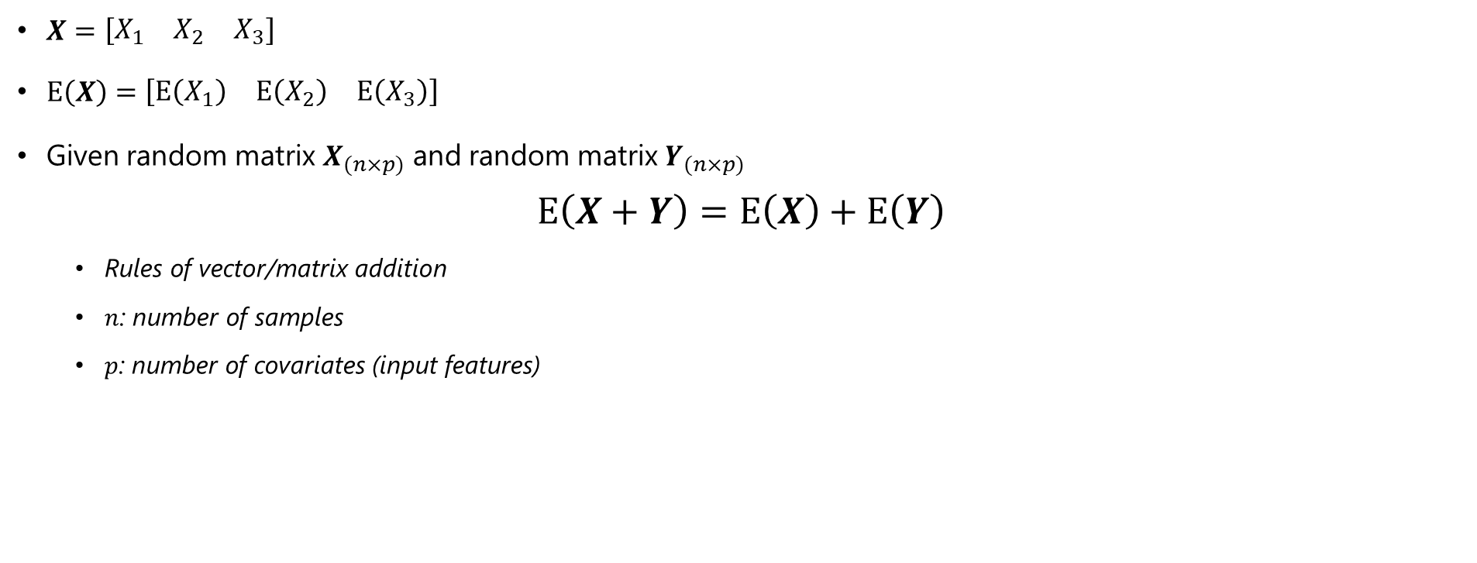
Random Vector
Rules for means
$X=\left[\begin{matrix}X_{1} & X_{2} & X_{3}\end{matrix}\right]$
$E\left(X\right)=\left[\begin{matrix}E\left(X_{1}\right) & E\left(X_{2}\right) & E\left(X_{3}\right)\end{matrix}\right]$
Given random matrix $X_{(n×p)}$ and random matrix $Y_{(n×p)}$ $E\left(X+Y\right)=E\left(X\right)+E\left(Y\right)$
Rules of vector/matrix addition
$n$: number of samples
$p$: number of covariates (input features)

Slide 22
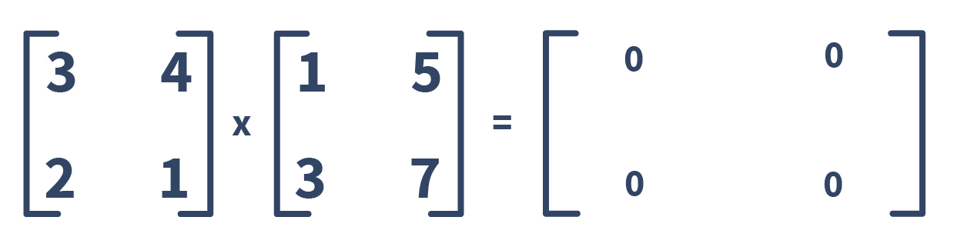
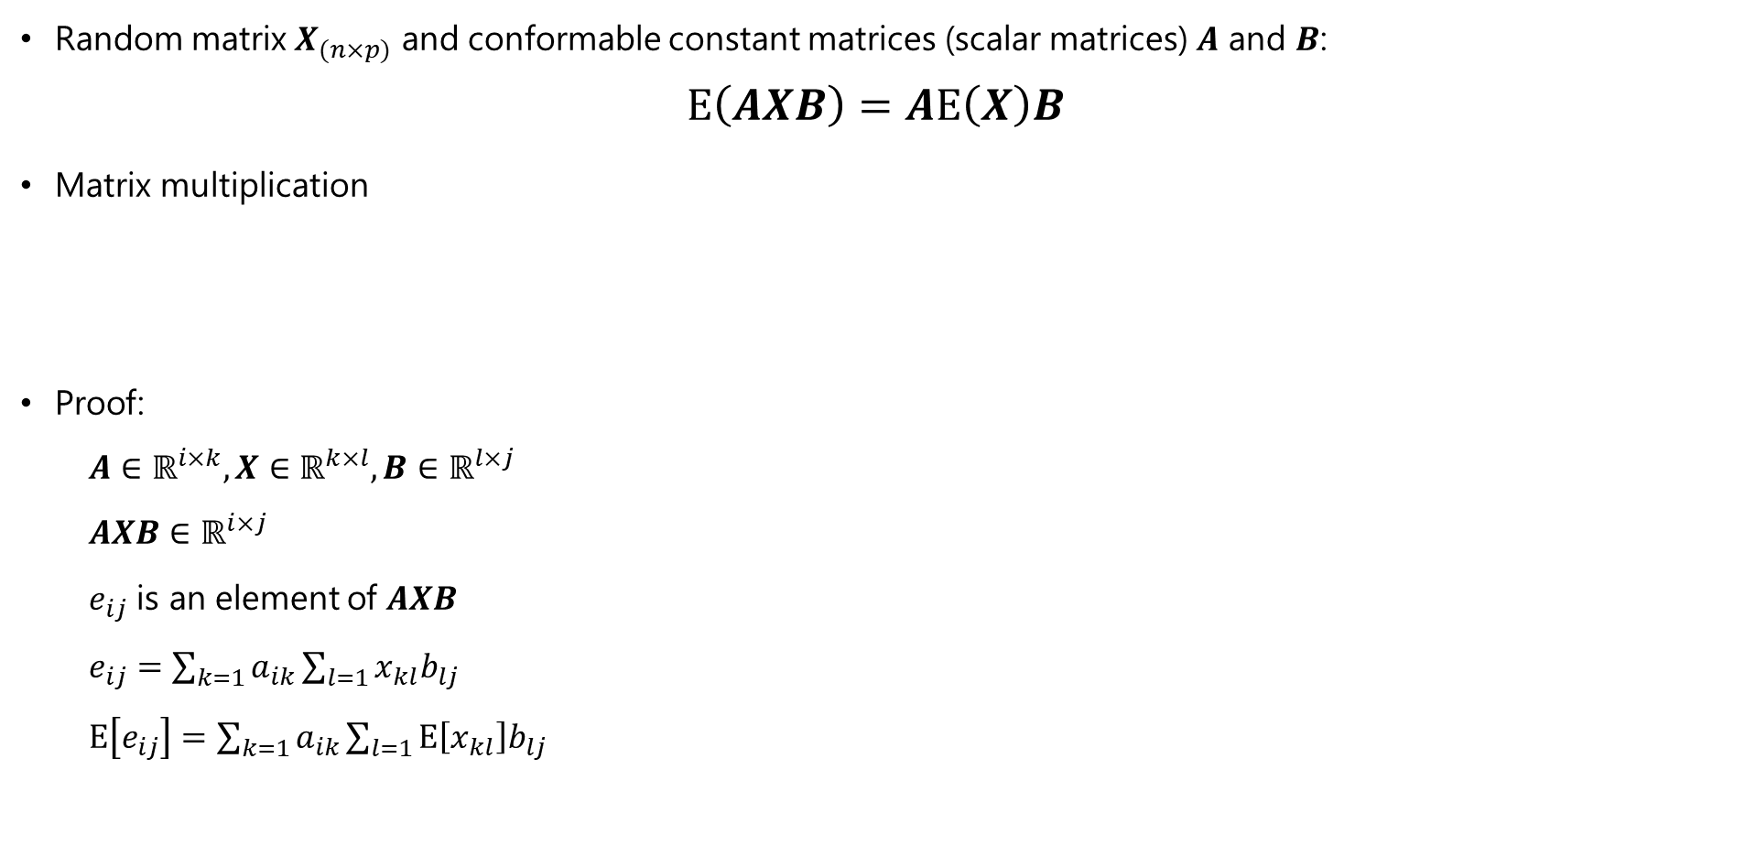
Random Vector
Random matrix $X_{(n×p)}$ and conformable constant matrices (scalar matrices) $A$ and $B$: $E\left(AXB\right)=AE\left(X\right)B$
Matrix multiplication
Proof:
$A∈ℝ^{i×k},X∈ℝ^{k×l},B∈ℝ^{l×j}$
$AXB∈ℝ^{i×j}$
$e_{ij}$ is an element of $AXB$
$e_{ij}=\sum_{k=1}^{ }{a_{ik}}\sum_{l=1}{x_{kl}b_{lj}}$
$E\left[e_{ij}\right]=\sum_{k=1}^{ }{a_{ik}}\sum_{l=1}{E\left[x_{kl}\right]b_{lj}}$

Slide 23
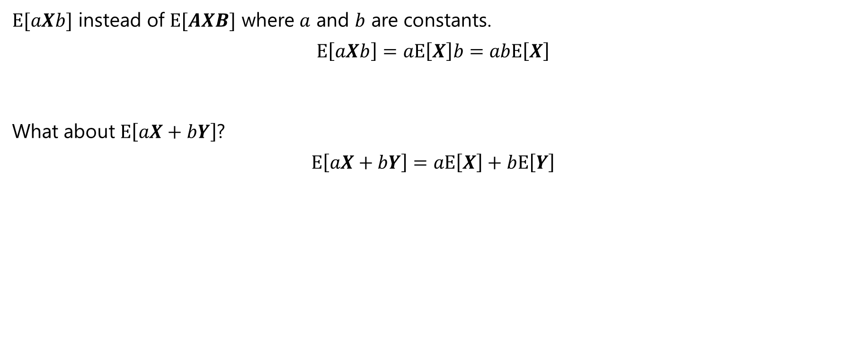
Random Vector
Q. What are the univariate analogue to the formula on the previous slide?
$E[aXb]$ instead of $E[AXB]$ where $a$ and $b$ are constants.
$$E\left[aXb\right]=aE\left[X\right]b=abE\left[X\right]$$
What about $E\left[aX+bY\right]$? $$E\left[aX+bY\right]=aE\left[X\right]+bE\left[Y\right]$$

Slide 24
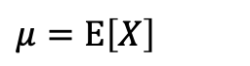
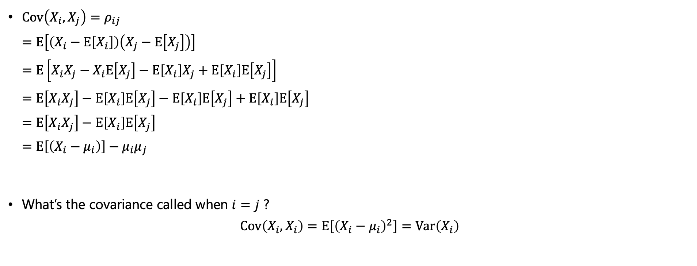
Random Vector
Covariance
$Cov\left(X_{i},X_{j}\right)=ρ_{ij}$ $=E\left[\left(X_{i}−E\left[X_{i}\right]\right)\left(X_{j}−E\left[X_{j}\right]\right)\right]$ $=E\left[X_{i}X_{j}−X_{i}E\left[X_{j}\right]−E\left[X_{i}\right]X_{j}+E\left[X_{i}\right]E\left[X_{j}\right]\right]$ $=E\left[X_{i}X_{j}\right]−E\left[X_{i}\right]E\left[X_{j}\right]−E\left[X_{i}\right]E\left[X_{j}\right]+E\left[X_{i}\right]E\left[X_{j}\right]$ $=E\left[X_{i}X_{j}\right]−E\left[X_{i}\right]E\left[X_{j}\right]$ $=E\left[\left(X_{i}−μ_{i}\right)\right]−μ_{i}μ_{j}$
What’s the covariance called when $i=j$ ? $Cov\left(X_{i},X_{i}\right)=E\left[{\left(X_{i}−μ_{i}\right)}^{2}\right]=Var\left(X_{i}\right)$
$$μ=E\left[X\right]$$

Slide 25
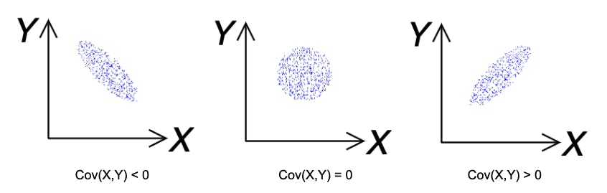
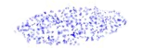

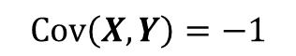
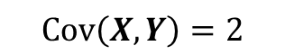



Random Vector
NB! The cov values are not exact but approximate for the example purpose.
Example of $Cov\left(X,Y\right)$
$$Cov\left(X,Y\right)=1$$
$$Cov\left(X,Y\right)=2$$
$$Cov\left(X,Y\right)=0$$
$$Cov\left(X,Y\right)=−1$$
$$Cov\left(X,Y\right)=−2$$

Slide 26













Random Vector
Variance-covariance matrix
Variance-covariance matrix $Σ$
$X∈ℝ^{p×n}$; random matrix (instead of random vector)
$Σ=Cov\left(X\right)=E\left[\left(X−μ\right){\left(X−μ\right)}^{T}\right]∈ℝ^{p×p}=E\left[XX^{T}\right]−μμ^{T}$
$$X_{1}$$
$$X_{2}$$
$$T$$
$$X_{1}$$
$$x_{11}$$ | $$x_{12}$$ | $$⋯$$ | $$x_{1p}$$
$$x_{21}$$ | $$x_{22}$$ | $$⋯$$ | $$x_{2p}$$
$$⋮$$ | $$⋮$$ | $$⋮$$ | $$⋮$$
$$x_{n1}$$ | $$x_{n2}$$ | $$⋯$$ | $$x_{np}$$
$$x_{11}$$ | $$x_{21}$$
$$x_{12}$$ | $$x_{22}$$
$$⋮$$ | $$⋮$$
$$x_{1p}$$ | $$x_{2p}$$
$$Σ$$
covariance
variance

Slide 27



Random Vector
Variance-covariance matrix
crime
rate
number of
rooms
owner’s
age
housing
price

Slide 28










Random Vector
Exercise: the variance-covariance matrix
$X∈ℝ^{p\left(=2\right)×n}={\left[X_{1},X_{2}\right]}^{T}$
$cov\left(X\right)∈ℝ^{2×2}$ $Σ=\left[\begin{matrix}σ_{1}^{2} & σ_{1}σ_{2} \\ σ_{2}σ_{1} & σ_{2}^{2}\end{matrix}\right]$
Q. What would be the correct $Σ$ ?
1
2
$$\left[\begin{matrix}5 & 4 \\ 4 & 6\end{matrix}\right]$$
$$\left[\begin{matrix}5 & −4 \\ −4 & 6\end{matrix}\right]$$
$$X_{2}$$
3
4
$$\left[\begin{matrix}5 & 0 \\ 0 & 1\end{matrix}\right]$$
$$\left[\begin{matrix}1 & 0 \\ 0 & 5\end{matrix}\right]$$
$$X_{1}$$

Slide 29
Random Vector
Exercise: the variance-covariance matrix
$X∈ℝ^{p\left(=2\right)×n}={\left[X_{1},X_{2}\right]}^{T}$
$cov\left(X\right)∈ℝ^{2×2}$ $Σ=\left[\begin{matrix}σ_{1}^{2} & σ_{1}σ_{2} \\ σ_{2}σ_{1} & σ_{2}^{2}\end{matrix}\right]$
Q. What would be the correct $Σ$ ?
1
2
$$\left[\begin{matrix}5 & 4 \\ 4 & 6\end{matrix}\right]$$
$$\left[\begin{matrix}5 & −4 \\ −4 & 6\end{matrix}\right]$$
$$X_{2}$$
3
4
$$\left[\begin{matrix}5 & 0 \\ 0 & 1\end{matrix}\right]$$
$$\left[\begin{matrix}1 & 0 \\ 0 & 5\end{matrix}\right]$$
$$X_{1}$$

Slide 30
Random Vector
Exercise: the variance-covariance matrix
$X∈ℝ^{p\left(=2\right)×n}={\left[X_{1},X_{2}\right]}^{T}$
$cov\left(X\right)∈ℝ^{2×2}$ $Σ=\left[\begin{matrix}σ_{1}^{2} & σ_{1}σ_{2} \\ σ_{2}σ_{1} & σ_{2}^{2}\end{matrix}\right]$
Q. What would be the correct $Σ$ ?
1
2
$$\left[\begin{matrix}5 & 4 \\ 4 & 6\end{matrix}\right]$$
$$\left[\begin{matrix}5 & −4 \\ −4 & 6\end{matrix}\right]$$
$$X_{2}$$
3
4
$$\left[\begin{matrix}5 & 0 \\ 0 & 1\end{matrix}\right]$$
$$\left[\begin{matrix}1 & 0 \\ 0 & 5\end{matrix}\right]$$
$$X_{1}$$

Slide 31
Random Vector
Exercise: the variance-covariance matrix
$X∈ℝ^{p\left(=2\right)×n}={\left[X_{1},X_{2}\right]}^{T}$
$cov\left(X\right)∈ℝ^{2×2}$ $Σ=\left[\begin{matrix}σ_{1}^{2} & σ_{1}σ_{2} \\ σ_{2}σ_{1} & σ_{2}^{2}\end{matrix}\right]$
Q. What would be the correct $Σ$ ?
1
2
$$\left[\begin{matrix}5 & 4 \\ 4 & 6\end{matrix}\right]$$
$$\left[\begin{matrix}5 & −4 \\ −4 & 6\end{matrix}\right]$$
$$X_{2}$$
3
4
$$\left[\begin{matrix}5 & 0 \\ 0 & 1\end{matrix}\right]$$
$$\left[\begin{matrix}1 & 0 \\ 0 & 5\end{matrix}\right]$$
$$X_{1}$$

Slide 32




Random Vector
Correlation matrix
Correlation matrix $ρ$ vs Covariance matrix $Σ$
$$ρ=$$
$$Σ=$$
$ρ$ is a normalized version of $Σ$

Slide 33




Random Vector
Correlation matrix
Correlation matrix $ρ$ vs Covariance matrix $Σ$
$$ρ=$$
$$=$$
$ρ$ is a normalized version of $Σ$
$ρ∈\left[−1,1\right]$

Slide 34



Random Vector
How does $ρ$ look?
$$X_{j}$$
$$X_{i}$$

Slide 35





Random Vector
How does $ρ$ look?
$$ρ=\left[\begin{matrix}1 & 0.8 \\ 0.8 & 1\end{matrix}\right]$$
$$ρ=\left[\begin{matrix}1 & −0.8 \\ −0.8 & 1\end{matrix}\right]$$
$$ρ=\left[\begin{matrix}1 & 0 \\ 0 & 1\end{matrix}\right]$$
$$ρ=\left[\begin{matrix}1 & 0 \\ 0 & 1\end{matrix}\right]$$

Slide 36

Random Vector
Correlation matrix on the Boston Housing price dataset
crime
rate
number of
rooms
owner’s
age
housing
price

Slide 37


Random Vector
Linear combinations
Proof of $Cov\left(Z\right)$ $=E\left[\left(Z−E\left[Z\right]\right){\left(Z−E\left[Z\right]\right)}^{T}\right]$
$=E\left[\left(CX−E\left[CX\right]\right){\left(CX−E\left[CX\right]\right)}^{T}\right]$
$=E\left[\left(CX−CE\left[X\right]\right){\left(CX−CE\left[X\right]\right)}^{T}\right]$
$=E\left[\left(CX−Cμ_{X}\right){\left(CX−Cμ_{X}\right)}^{T}\right]$
$=E\left[C\left(X−μ_{X}\right){\left(C\left(X−μ_{X}\right)\right)}^{T}\right]$
$=E\left[C\left(X−μ_{X}\right){\left(X−μ_{X}\right)}^{T}C^{T}\right]$
$=CE\left[\left(X−μ_{X}\right){\left(X−μ_{X}\right)}^{T}\right]C^{T}$
$=CΣ_{X}C^{T}$
$Z=CX$
scalar matrix $C∈ℝ^{k×p}$
random matrix $X∈ℝ^{p×n}$
Then,
$E\left(Z\right)=E\left(CX\right)=CE\left(X\right)=Cμ_{X}$
$Cov\left(Z\right)=Cov\left(CX\right)=CΣ_{X}C^{T}$
$μ_{X}$: $μ$ of $X$
$Σ_{X}$: $Σ$ of $X$

Slide 38


Random Vector
Univariate case of $Cov\left(Z\right)$
Proof of $Var\left(cX\right)$ $Var\left(X\right)=E\left[{\left(X−E\left[X\right]\right)}^{2}\right]$
$Var\left(cX\right)=E\left[{\left(cX−E\left[cX\right]\right)}^{2}\right]$
$=E\left[{\left(cX−cE\left[X\right]\right)}^{2}\right]$
$=E\left[{\left(c\left(X−E\left[X\right]\right)\right)}^{2}\right]$
$=E\left[{c^{2}\left(X−E\left[X\right]\right)}^{2}\right]$
$=c^{2}E\left[{\left(X−E\left[X\right]\right)}^{2}\right]$
$=c^{2}Var\left(X\right)$
$Z=cX$
scalar $c$
random matrix $X∈ℝ^{p×n}$
Then,
$Var\left(cX\right)=c^{2}Var(X)$

Slide 39








Random Vector
Exercise: Linear combinations
$X={\left[X_{1},X_{2},X_{3},X_{4}\right]}^{T}$
Find $C$ such that $CX=Y$
$Y={\left[\begin{matrix}X_{1}−X_{3} & \begin{matrix}X_{2}+X_{4} & \left(X_{2}+X_{4}\right)−\left(X_{1}+X_{3}\right)\end{matrix}\end{matrix}\right]}^{T}$
$$X_{1}$$
$$X_{2}$$
$$X_{3}$$
$$X_{4}$$
$$X_{1}−X_{3}$$
$$X_{2}+X_{4}$$
$$\left(X_{2}+X_{4}\right)−\left(X_{1}+X_{3}\right)$$
$$c_{11}$$ | $$c_{12}$$ | $$c_{13}$$ | $$c_{14}$$
$$c_{21}$$ | $$c_{22}$$ | $$c_{23}$$ | $$c_{24}$$
$$c_{31}$$ | $$c_{32}$$ | $$c_{33}$$ | $$c_{34}$$
$$=$$
$$Y$$
$$C$$
$$X$$

Slide 40

Random Vector
Exercise: Linear combinations
$X={\left[X_{1},X_{2},X_{3},X_{4}\right]}^{T}$
Find $C$ such that $CX=Y$
$Y={\left[\begin{matrix}X_{1}−X_{3} & \begin{matrix}X_{2}+X_{4} & \left(X_{2}+X_{4}\right)−\left(X_{1}+X_{3}\right)\end{matrix}\end{matrix}\right]}^{T}$
$$X_{1}$$
$$X_{2}$$
$$X_{3}$$
$$X_{4}$$
$$X_{1}−X_{3}$$
$$X_{2}+X_{4}$$
$$\left(X_{2}+X_{4}\right)−\left(X_{1}+X_{3}\right)$$
$$1$$ | $$0$$ | $$−1$$ | $$0$$
$$c_{21}$$ | $$c_{22}$$ | $$c_{23}$$ | $$c_{24}$$
$$c_{31}$$ | $$c_{32}$$ | $$c_{33}$$ | $$c_{34}$$
$$=$$
$$Y$$
$$C$$
$$X$$

Slide 41



Random Vector
Exercise: Linear combinations
$X={\left[X_{1},X_{2},X_{3},X_{4}\right]}^{T}$
Find $C$ such that $CX=Y$
$Y={\left[\begin{matrix}X_{1}−X_{3} & \begin{matrix}X_{2}+X_{4} & \left(X_{2}+X_{4}\right)−\left(X_{1}+X_{3}\right)\end{matrix}\end{matrix}\right]}^{T}$
$$X_{1}$$
$$X_{2}$$
$$X_{3}$$
$$X_{4}$$
Then, $Cov\left(Y\right)?$
$$Cov\left(Y\right)=CCov\left(X\right)C^{T}=CΣ_{X}C^{T}$$
$$X_{1}−X_{3}$$
$$X_{2}+X_{4}$$
$$\left(X_{2}+X_{4}\right)−\left(X_{1}+X_{3}\right)$$
$$1$$ | $$0$$ | $$−1$$ | $$0$$
$$0$$ | $$1$$ | $$0$$ | $$1$$
$$−1$$ | $$1$$ | $$−1$$ | $$1$$
$$=$$
$$Y$$
$$C$$
$$X$$

Slide 42
Quiz

Slide 43

Quiz
Q1: Mean of sum
Q. $X$ and $Y$ are two bivariate random vectors with $E\left(X\right)={\left(1,2\right)}^{T}$ and $E\left(Y\right)={\left(2,0\right)}^{T}$.
What is $E\left(X+Y\right)$?
A: ${\left(1.5, 1\right)}^{T}$
B: ${\left(3, 2\right)}^{T}$
C: ${\left(−1, 2\right)}^{T}$
D: ${\left(1, −2\right)}^{T}$
Notes:
B

Slide 44

Quiz
Q2: Mean of linear combination
Q. $X$ is a 2-dimaensional random vector with $E\left[X\right]={\left(2, 5\right)}^{T}$, and $b={\left(0.5, 0.5\right)}^{T}$ is a constant vector. What is $E\left[b^{T}X\right]$?
A: 3.5
B: 7
C: 2
D: 5
Notes:
A

Slide 45

Quiz
Q3: Covariance
Q. $X$ is a $p$-dimensional random vector with mean $μ$, and $X∈ℝ^{p×n}$. Which of the following defines the covariance matrix?
A: $E\left[{\left(X−μ\right)}^{T}\left(X−μ\right)\right]$
B: $E\left[\left(X−μ\right){\left(X−μ\right)}^{T}\right]$
C: $E\left[\left(X−μ\right)\left(X−μ\right)\right]$
D: $E\left[{\left(X−μ\right)}^{T}{\left(X−μ\right)}^{T}\right]$
Notes:
B

Slide 46
Multivarite Normal Distribution

Slide 47


Multivarite Normal (mvN) Distribution
Why is the mvN distribution so popular?
Many natural phenomena can be modeled with it.
Good interpretability of covariance
Mathematically tractable
Used as a building block in many methods

Slide 48

Multivarite Normal Distribution
Multivarite Normal (mvN) Distribution

Slide 49


Multivarite Normal Distribution
Multivariate Normal Probability Density Function (PDF)

Slide 50




Multivarite Normal Distribution
Useful properties of the mvN distribution
The graphical contours of the mvN are ellipsoids:
Linear combinations of components of $X$ are (multivariate) normal.
e.g., If $X_{1}$ and $X_{2}$ are normal and indepdent, then $X_{1}+X_{2}$ is also normal,.
All subsets of components of $X$ are (multivariate) normal.
Zero covariance implies that the correponding components are independently distributed.

Slide 51
Multivarite Normal Distribution
Some note
All of these are proven in TMA2467 Linear Statistical Models.

Slide 52

Multivarite Normal Distribution
Wait! Why are we learning it?
In M4 (classification), the mvN is very important!
LDA is a supervised linear transformation technique, to maximize the separation between different classes.

Slide 53
Quiz

Slide 54

Quiz
Question 1: Multivariate Normal PDF
The mvN distribution is expressed as
Q. What is ?
Notes:
A

Slide 55

Quiz
Question 2: Multivariate normal distribution
Notes:
D

Slide 56

Multivarite Normal Distribution
Question 3: Independence
Notes:
B

Slide 57

Multivarite Normal Distribution
Question 4: Constructing independent variables?
Notes:
B

Slide 58

The End!

